Slide 1

Sales Insight
Using powerBI

Slide 2
Problem Statement
ABC Hardwares – a computer hardware business facing challenges to increase revenue in a dynamically changing market. The sales director needs a dashboard that can give him real-time sales insights that will provide him insights to increase revenue.

Slide 3
What Can I Do:
As a data analyst, I will provide this dashboard to the sales director.
Domain: FMCG
Function: Sales

Slide 4
Skills Acquired:
Tech: SQL, Power BI.
Core: Business understanding, analytical mindset.

Slide 5
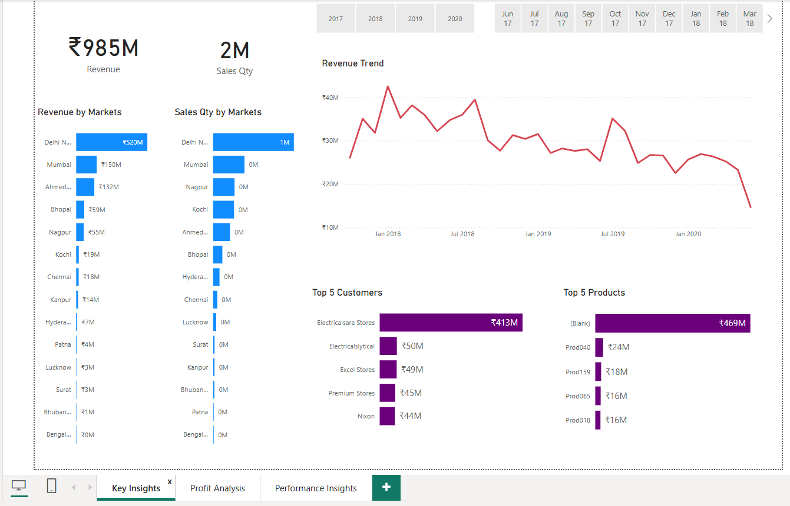
Key Insights
Sales Quantity by Market:
Delhi leads with 968K sales units, followed by Mumbai (383K) and Nagpur (262K).
Markets like Bengaluru (0.41K) have significantly low sales, requiring attention.
Electricalsara Stores (₹413M) is the highest revenue-contributing customer

Slide 6
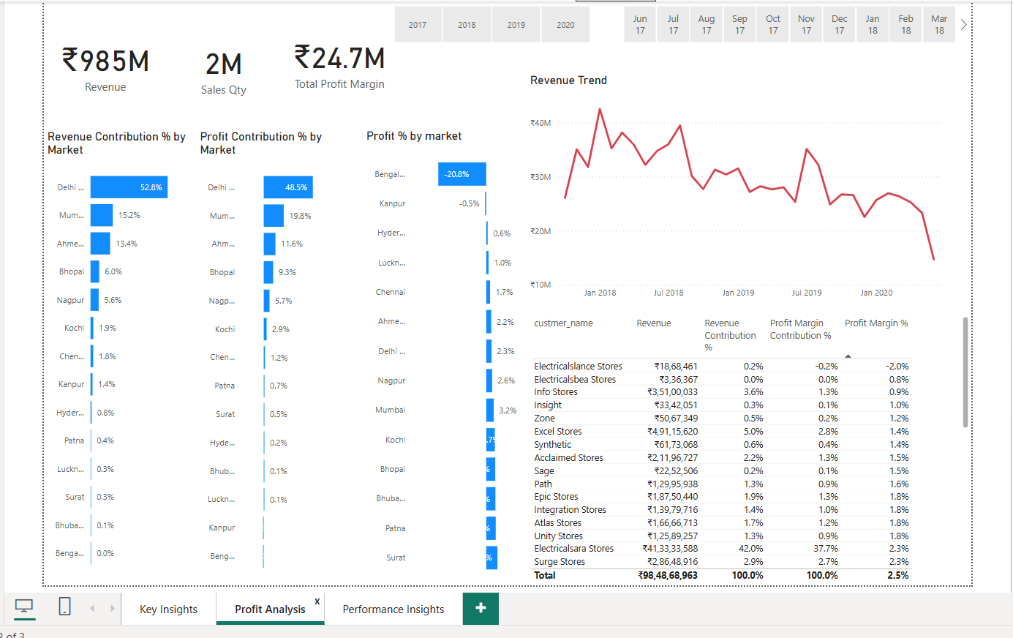
Profit Analysis
Revenue Trend (Top Right)
The trend shows fluctuations, with periods of high revenue followed by declines.
The drop in revenue towards early 2020 might indicate a market slowdown
Profit Contribution % by Market
Delhi (48.5%), Mumbai, and Ahmedabad are the top contributors to profit.
However, some markets, like Bengaluru, are experiencing losses.
Kanpur (-0.5%) also has a negative profit contribution, indicating poor profitability.
.

Slide 7
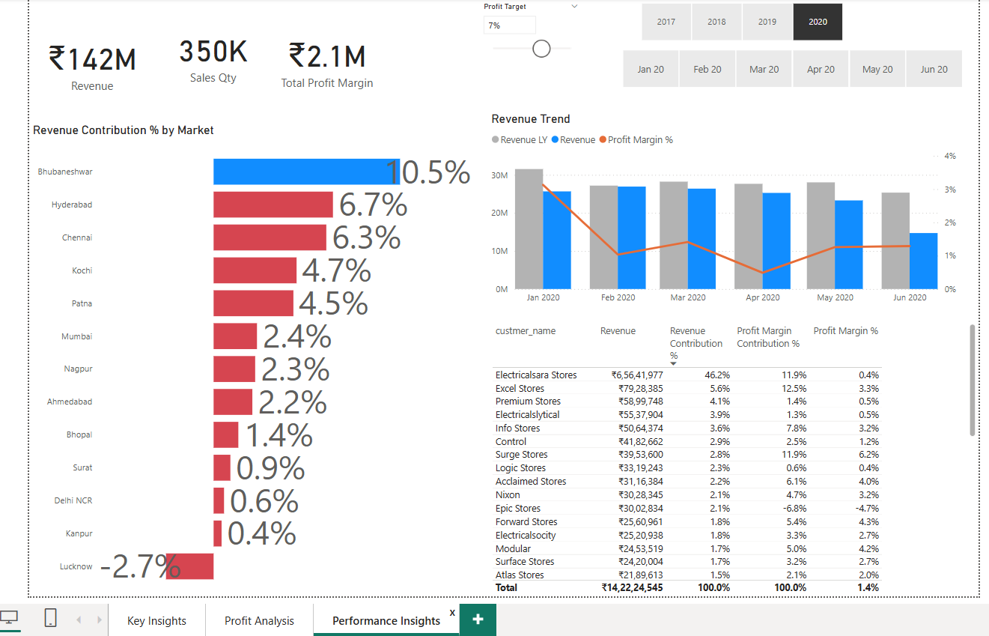
Performance Insights
Revenue Contribution % by Market.
Bhubaneswar (10.5%) is the top-performing market, while Lucknow (-2.7%) has a negative contribution.
Electricalsara Stores is the top revenue contributor (₹6.56 crore, 46.2%).

Slide 8

Result:
The dashboard enabled quick, data-informed decisions, effectively displaying sales trends and potentially raising revenue by at least 7% in the next quarter.

